Slide 1


Slide 2
GIS Application in Telecom
A 5-Day Intensive Training Program
Duration: 5 Days (9:00 AM – 3:00 PM)
Format: Instructor-led · Theory + Hands-on Labs
GIS Platform: ArcGIS Pro / ArcMap
August 2026
GIS Application in Telecom | Day 1 2 / 51

Slide 3
Overall Agenda of Five Days Training
Day 1 | GIS concepts & data types; coordinate systems (datum, WGS84, GCS/PCS); ArcGIS Pro; geodatabase, domains/subtypes, relationships; raster analysis & DEM.
Day 2 | Coverage Analysis, RF Planning & Network Expansion.
Day 3 | Geo-Marketing & Customer Analytics
Day 4 | Fiber, Transmission & Microwave Link Planning
Day 5 | Network Visualization, Reporting & Capstone Case Study. Using ArcGIS Online platform with available tools.
GIS Application in Telecom | Day 1 3 / 51

Slide 4
Day 1 Overview
Introduction to GIS, concepts, components and data fundamentals; coordinate systems; ArcGIS Pro; geodatabase design (feature classes, feature datasets, domains, subtypes, relationship classes); raster analysis and DEM.
GIS Application in Telecom | Day 1 4 / 51

Slide 5
Day 1 Agenda
This agenda matches the slides that follow.
Part 1 — GIS concepts and data types
What GIS is: keywords, functions, and system components
Vector vs raster; attributes, tables, and metadata
Vector and raster formats — advantages and limits
Part 2 — Coordinate systems
Shape of the Earth, geoid, datum, and WGS84
Geographic vs projected coordinates (GCS / PCS, UTM)
Part 3 — ArcGIS Pro and the geodatabase
ArcGIS Pro workspace; geodatabase types; shapefile vs feature class; feature dataset
Domains and subtypes; relationship classes, ERD, and cardinality
Worked example: irrigation hierarchy (1:M) and the telecom parallel (OLT → FDH → home)
Part 4 — Raster analysis and DEM
Raster overlay, weighted overlay, resolution; DEM sources and derivatives
Hands-on: explore the same ideas in ArcGIS Pro
GIS Application in Telecom | Day 1 5 / 51

Slide 6
Day 1 Learning Outcomes
By the end of Day 1 you will be able to:
Explain GIS as a system (data, software, hardware, people, methods) used for telecom decisions.
Choose vector or raster for a given question (network assets vs coverage / terrain).
Distinguish GCS vs projected CRS, and explain datum and WGS84 (why GPS and maps must match).
Open ArcGIS Pro and recognise a file geodatabase, feature class, and feature dataset.
Describe domains and subtypes as rules that keep network attributes consistent.
Read an ERD and cardinality (1:1, 1:M, M:N) and map it to OLT → FDH → splitter → home.
Describe raster overlay / DEM use for slope, cost, viewshed, and site screening.
GIS Application in Telecom | Day 1 6 / 51

Slide 7
Part 1 · GIS Concepts and Data Types
Definition, components, vector and raster
GIS Application in Telecom | Day 1 7 / 51

Slide 8
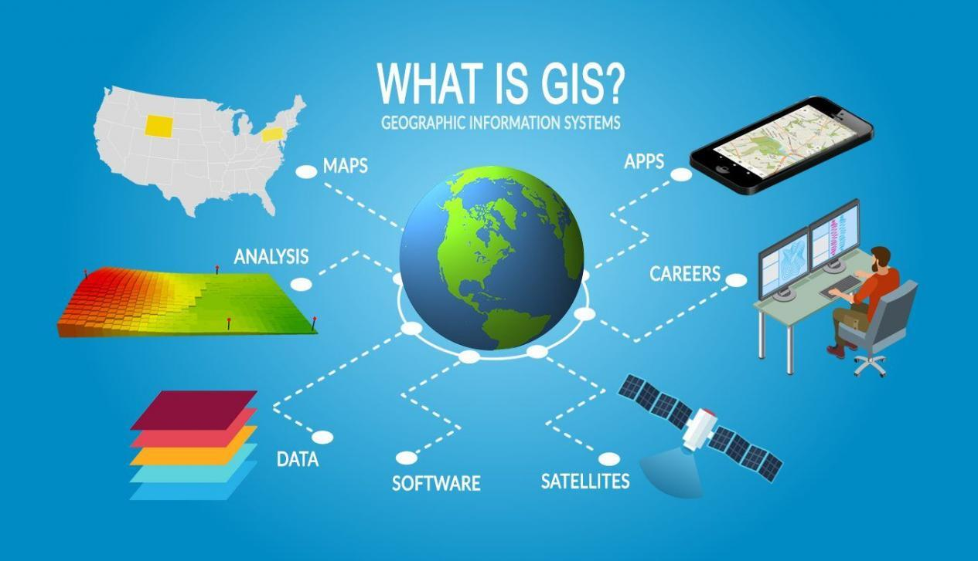
What is GIS
A Geographic Information System (GIS) is a system designed to capture, store, manipulate, analyze, manage, and present all types of geographically referenced data. Although the term GIS is commonly used to describe software packages, a true GIS includes knowledgeable staff, hardware, data, and software.
A GIS integrates hardware, software, and data to help people understand patterns, relationships, and trends in geographic information. It answers questions like "where," "what's nearby," "how has this changed over time," and "what patterns exist across space."
GIS Application in Telecom | Day 1 8 / 51

Slide 9
GIS Keywords
Geographic - The key word is geography which means that the data and information are associated with some location in space or referenced to the locations on the earth.
Information - tabular, attributes, or the characteristics (data), can be used to symbolize and provide further insight into a given location.
Systems - a seamless operation linking the information to the geography - which requires hardware, networks, software, data, and operational procedures
GIS Application in Telecom | Day 1 9 / 51

Slide 10
GIS Functions
GIS uses spatial and non-spatial attribute data to answer questions about the real world. Spatial analysis is what distinguishes GIS from other applications.
Data acquisition – collecting geographic data via GPS, satellite imagery, surveys
Storage – organizing spatial and attribute data in databases
Analysis – spatial analysis such as proximity, overlay, network analysis
Visualization – producing maps, 3D models, and dashboards
Data management – integrating and updating datasets over time
GIS Application in Telecom | Day 1 10 / 51

Slide 11
Key GIS Components
Hardware – computers, GPS devices, drones, satellites, servers
Software – programs like ArcGIS Pro, QGIS, or Google Earth Engine that process spatial data
Data – two main types:
Spatial data: coordinates, shapes, boundaries (points, lines, polygons)
Attribute data: descriptive info about those features (e.g., population, land use, elevation)
People – analysts, planners, and scientists who design workflows and interpret results
Methods/Procedures – models and workflows for analysis (e.g., overlay analysis, buffering, spatial queries)
GIS Application in Telecom | Day 1 11 / 51

Slide 12
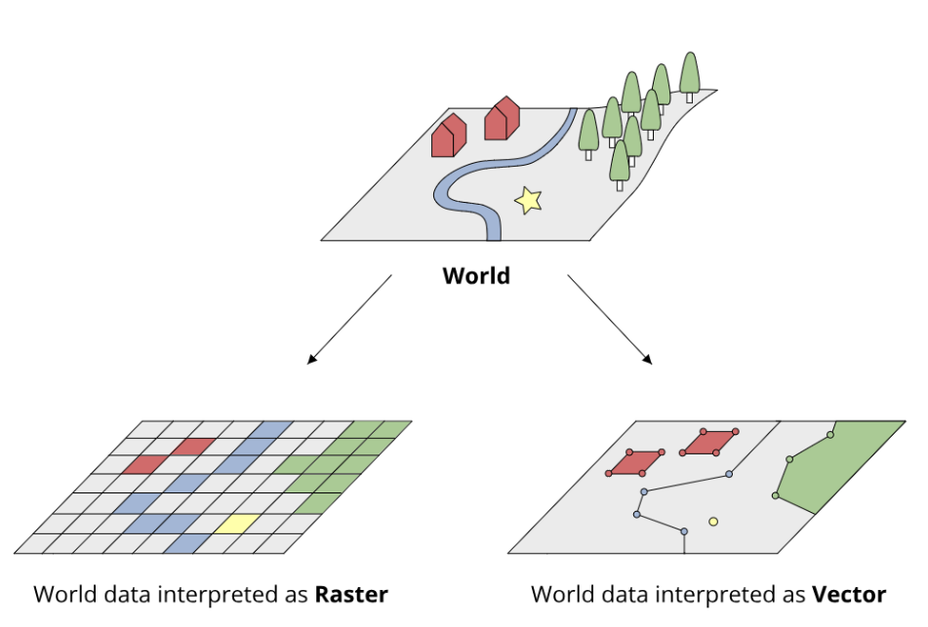
Fundamental Data Types Used in GIS
Vector Data is a representation of the world using points, lines, and polygons. Vector models are useful for storing data that has discrete boundaries, such as country borders, land parcels, and streets
Raster Data is a representation of the world as a surface divided into a regular grid of cells. Raster data are useful for storing data that varies continuously, as in an aerial photograph, a satellite image, a surface of chemical concentrations, or an elevation surface
GIS Application in Telecom | Day 1 12 / 51

Slide 13
Other Key Data Types in GIS
Beyond spatial data (vector/raster), a functioning GIS relies on several other data types that give geographic features meaning, context, and trustworthiness
Attribute Data: Descriptive information attached to spatial features — the "what" behind the "where."
Stored in tables linked to each point, line, or polygon
Example: a road (line feature) might have attributes like name and length
Tabular / Non-Spatial Data: Regular data tables (like a census spreadsheet) that don't have inherent location but can be joined to spatial features using a common key (e.g. ZIP code, county FIPS code).
Metadata: Data about the data — describes the dataset itself rather than the features in it.
Includes: source, date collected, coordinate system/projection, accuracy, resolution, author, update frequency, licensing
Critical for trust and reproducibility — tells you whether a dataset is current, reliable, and fit for your purpose
Standards exist for this (e.g. ISO 19115, FGDC) so metadata is consistent across organizations
GIS Application in Telecom | Day 1 13 / 51

Slide 14
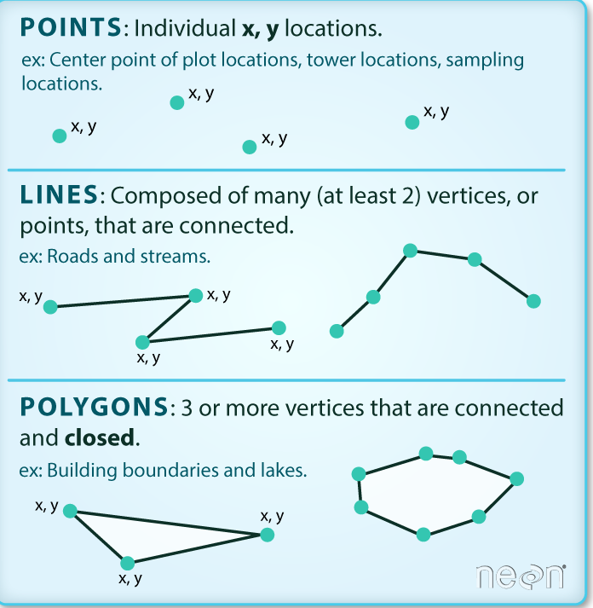
Vector Data Format
In vector data, objects are represented as points, lines or polygons, whose positions are precisely specified.
Advantages:
High precision — exact coordinates give sharp, accurate boundaries
Compact file size — only stores geometry + attributes, not every point in space
Easy to attach rich attribute data (tables) to each feature
Ideal for network analysis (routing, connectivity) since features are discrete and topological
Scales well — zooming in doesn't lose detail or create pixelation
Easy to edit individual features without affecting the whole dataset
Disadvantages:
Poor at representing continuous phenomena (elevation, temperature, rainfall) — everything must be broken into discrete shapes
Complex overlay/analysis operations (e.g. combining many polygon layers) can be computationally expensive
Doesn't handle "fuzzy" or gradually-changing boundaries well (e.g. soil transition zones)
Requires more complex data structures and topology rules to maintain validity
GIS Application in Telecom | Day 1 14 / 51

Slide 15
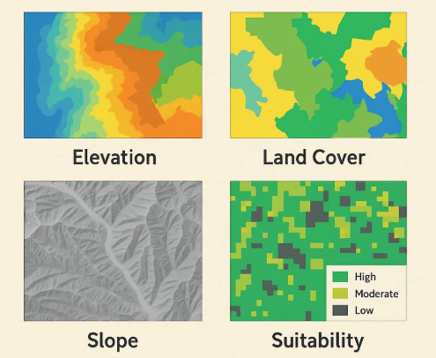
Raster Data Format
Raster data generalizes map features as cells or pixels in a grid matrix. The space is defined by a matrix of points or cells organized into rows and columns. In a raster dataset, data values for a given parameter are stored in each cell - these values may represent an elevation in meters above sea level, a land-use class, etc.
Scanned
Remotely Sensed
Aerial Photos
Satellite Photos
Digital Elevation Models (DEM)
Derived Rasters
Hillshade
Slope
Aspect
Viewshed
GIS Application in Telecom | Day 1 15 / 51

Slide 16
Advantages and Disadvantages of Raster
Disadvantages:
Larger file sizes, especially at high resolution
Loss of precision — boundaries look "blocky" or pixelated, especially at coarse resolution
Attribute data is limited — typically just one value per cell, not rich multi-field records
Resolution trade-off — fine detail requires huge file sizes; coarse resolution loses accuracy
Zooming in reveals pixelation rather than clean edges
Advantages:
Excellent for continuous data — elevation, temperature, satellite imagery, rainfall
Simple data structure — just a grid of values, easy to process mathematically
Fast for certain types of spatial analysis (overlay, map algebra, surface modeling). Naturally suited to remote sensing and satellite/drone imagery
Uniform structure makes it easy to combine multiple raster layers cell-by-cell
GIS Application in Telecom | Day 1 16 / 51

Slide 17
Part 2 · Coordinate Systems
Earth, datum, WGS84, geographic vs projected
GIS Application in Telecom | Day 1 17 / 51

Slide 18
Coordinate System
Coordinate systems enable geographic datasets to use common locations for integration. A coordinate system is a reference system used to represent the locations of geographic features, imagery, and observations such as GPS locations within a common geographic framework
Every place has an address using coordinates:
Latitude | How far north or south you are from the equator | ~34.5° N
Longitude | How far east or west you are from Greenwich, UK (like vertical slices of the orange) | ~69.2°
GIS Application in Telecom | Day 1 18 / 51

Slide 19
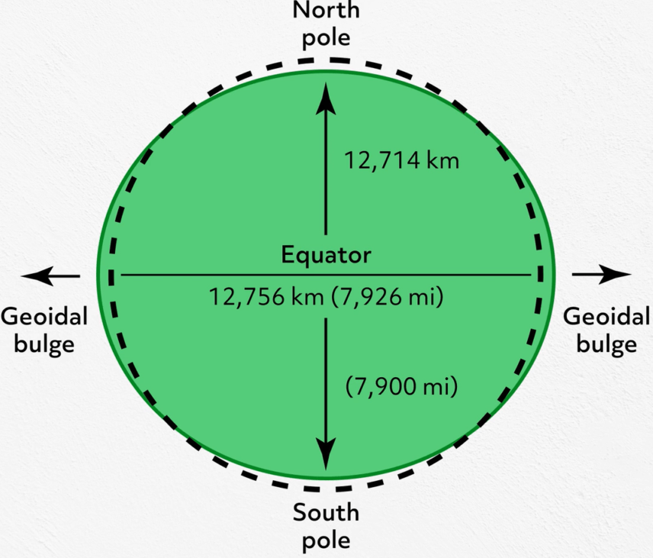
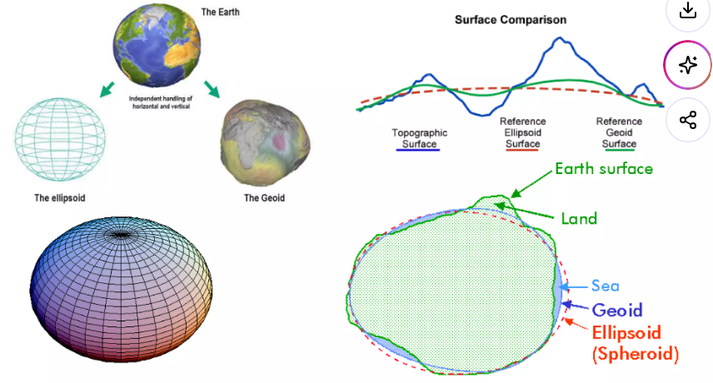
What Is the Shape of the Earth?
Earth is not a perfect sphere (like a football). A smooth mathematical model of Earth is an ellipsoid (spheroid) — slightly squashed at the poles. The true gravity surface is the geoid.
Polar diameter (north–south): ~12,714 km. Equatorial diameter (east–west): ~12,756 km. The difference is ~42 km.
GIS Application in Telecom | Day 1 19 / 51

Slide 20
What is a datum? 🌍
Simple definition: A datum is the model of Earth's shape that coordinates are measured from.
The size and shape of that football (the ellipsoid)
Where the center of the model sits relative to the real Earth
Analogy: Imagine two people measuring your height:
One stands you on the floor → 150 cm
One stands you on a thick book → 155 cm
Same person, different starting surface = different number.
Same real place on Earth, different datum = slightly different coordinates.
Why it matters: If Map A uses one datum and Map B uses another, a hospital, pipeline, or fiber cable can appear hundreds of meters in the wrong place when you overlay them.
These are some examples of different datums used: NAD27 / NAD83 (North American Datum), ETRS89 (European Terrestrial Reference System 1989), and WGS84
GIS Application in Telecom | Day 1 20 / 51

Slide 21
What is WGS84? 🛰️
WGS84 = World Geodetic System 1984. Simple definition: WGS84 is the most widely used global datum today. It is the datum behind GPS on your phone.
Feature | WGS84
Full name | World Geodetic System 1984
Ellipsoid | WGS 84 ellipsoid
Used by | GPS, Google Maps, most satellites, most modern GIS
EPSG code (geographic) | EPSG:4326
Units | Degrees (latitude, longitude)
Important: WGS84 is very accurate for global use. Some countries have local datums that were measured more carefully for one region.
GIS Application in Telecom | Day 1 21 / 51

Slide 22
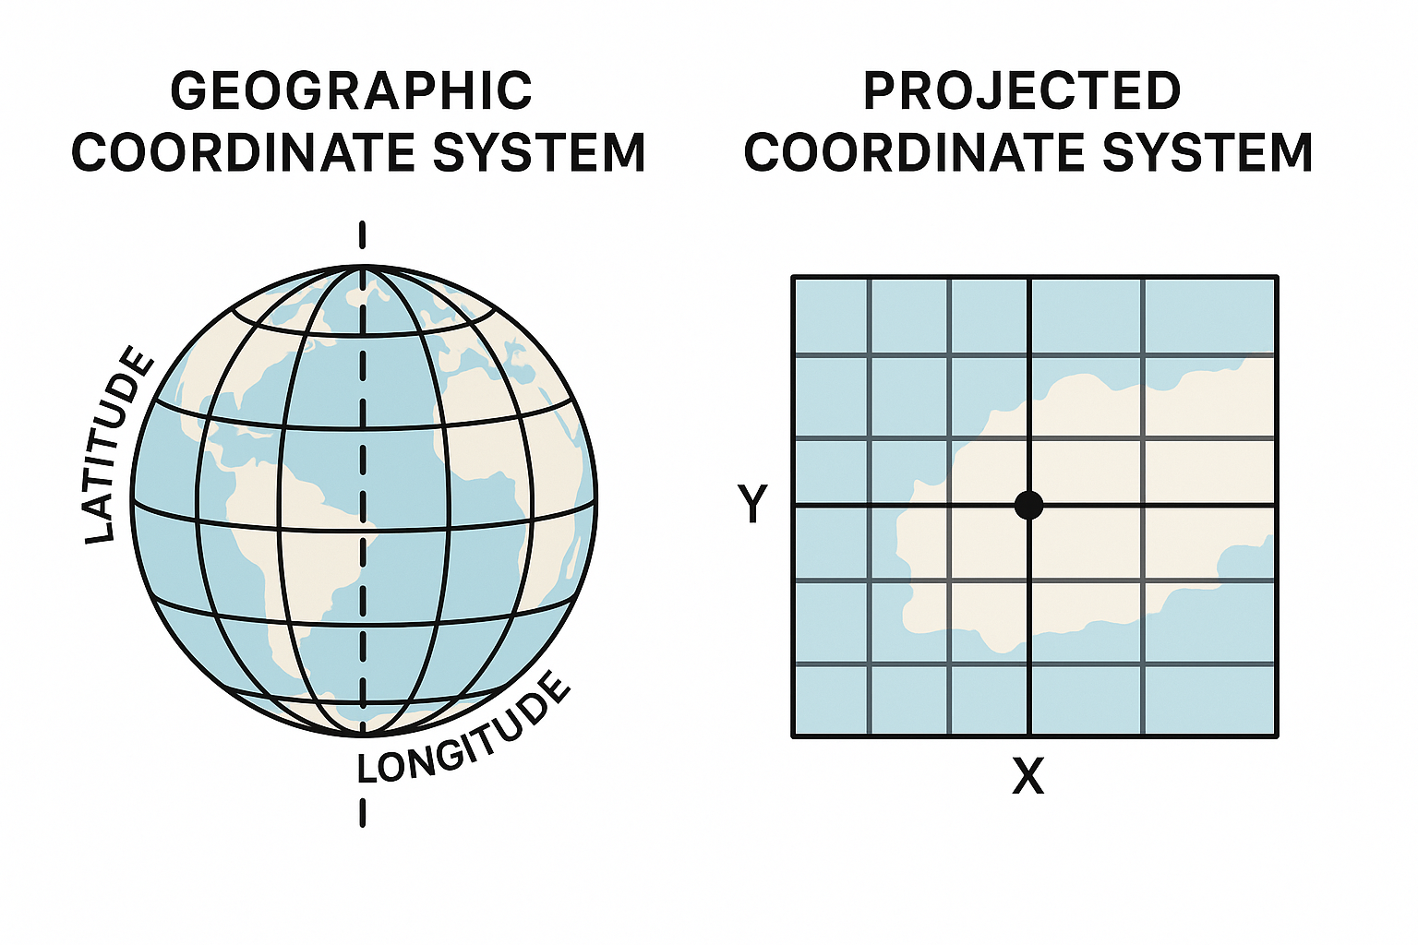
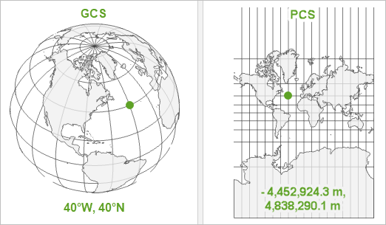
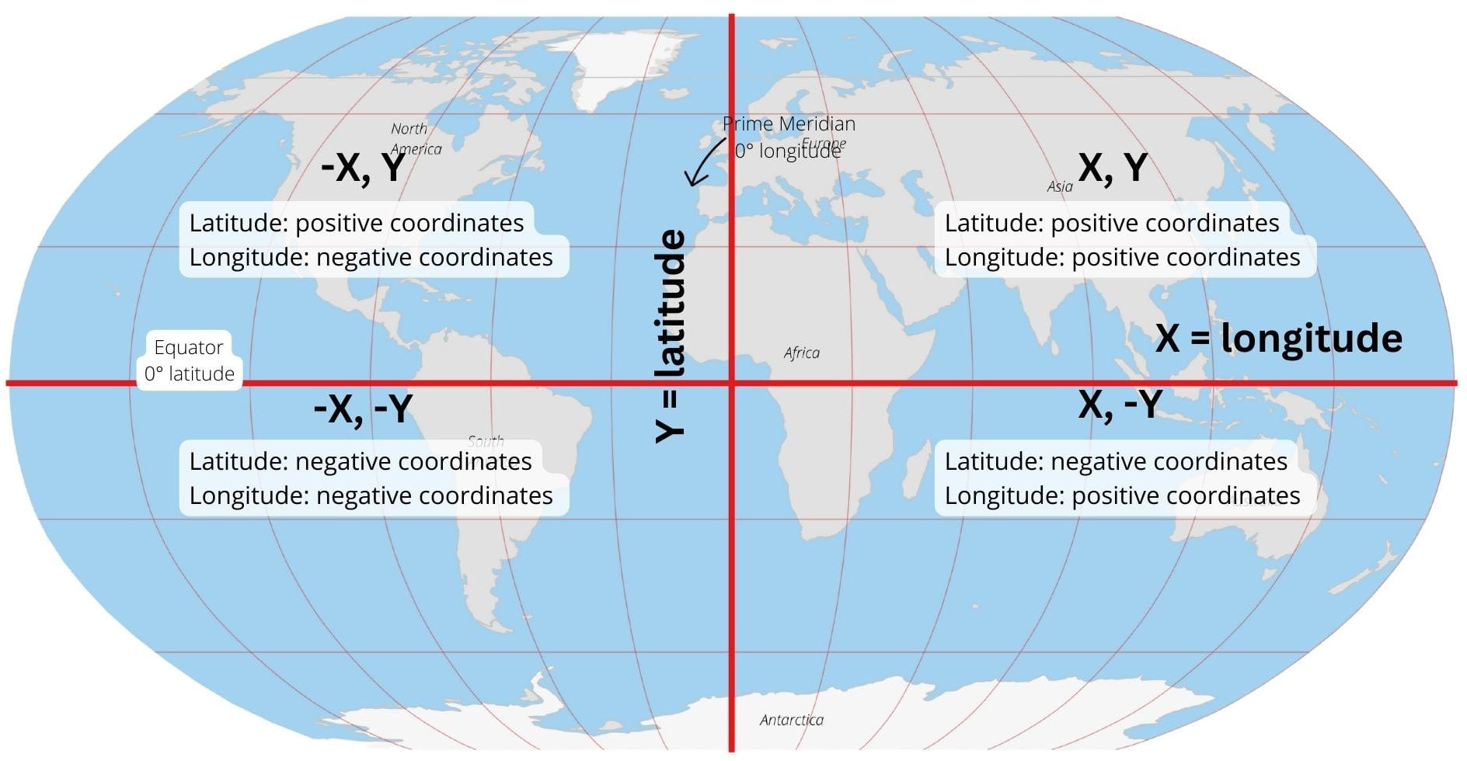
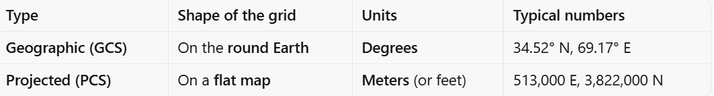
Types of Coordinate Systems
There are two types of coordinate system in GIS:
Geographic Coordinate System (GCS) and Projected Coordinate System (PCS)
GIS Application in Telecom | Day 1 22 / 51

Slide 23
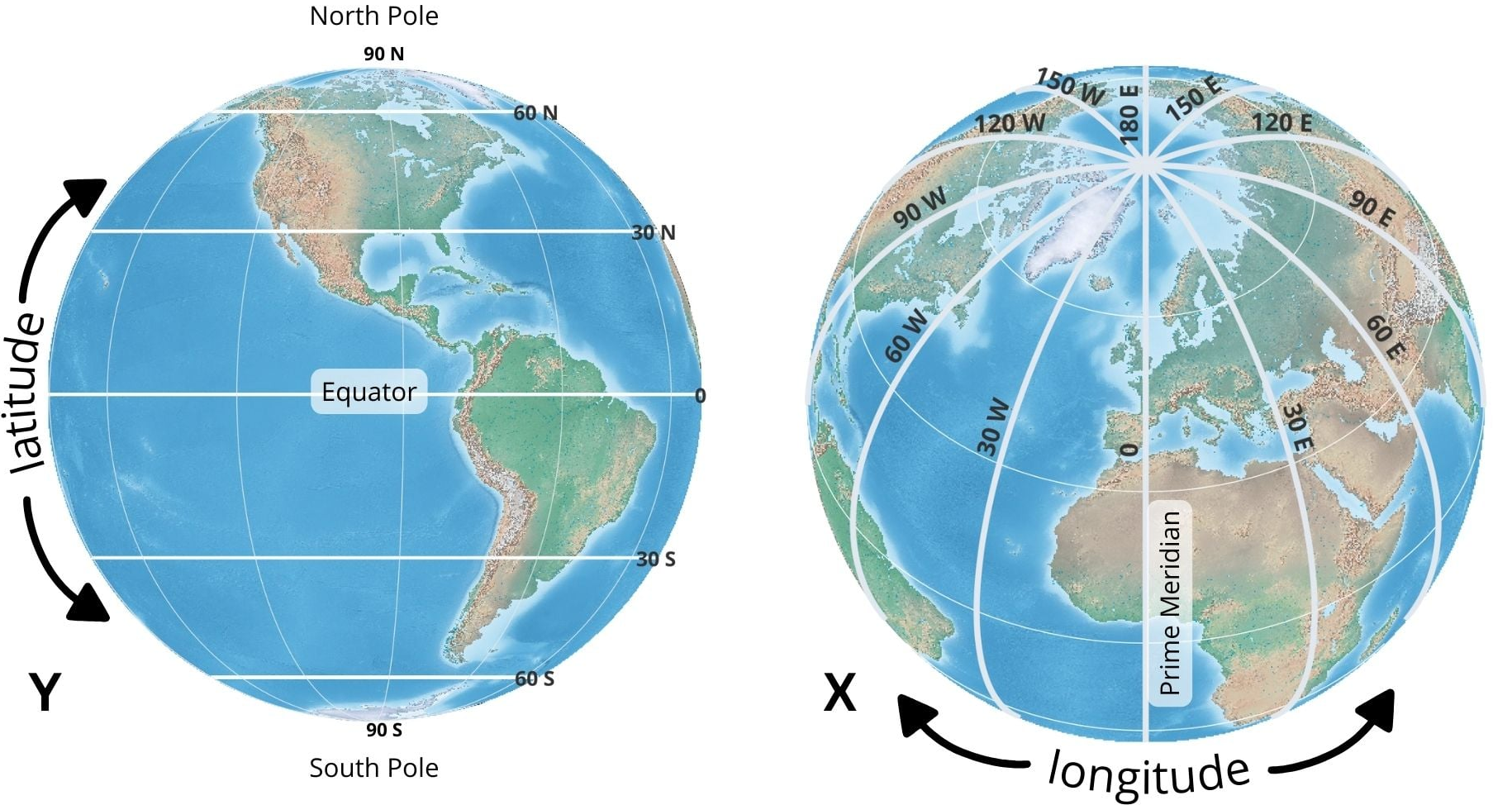
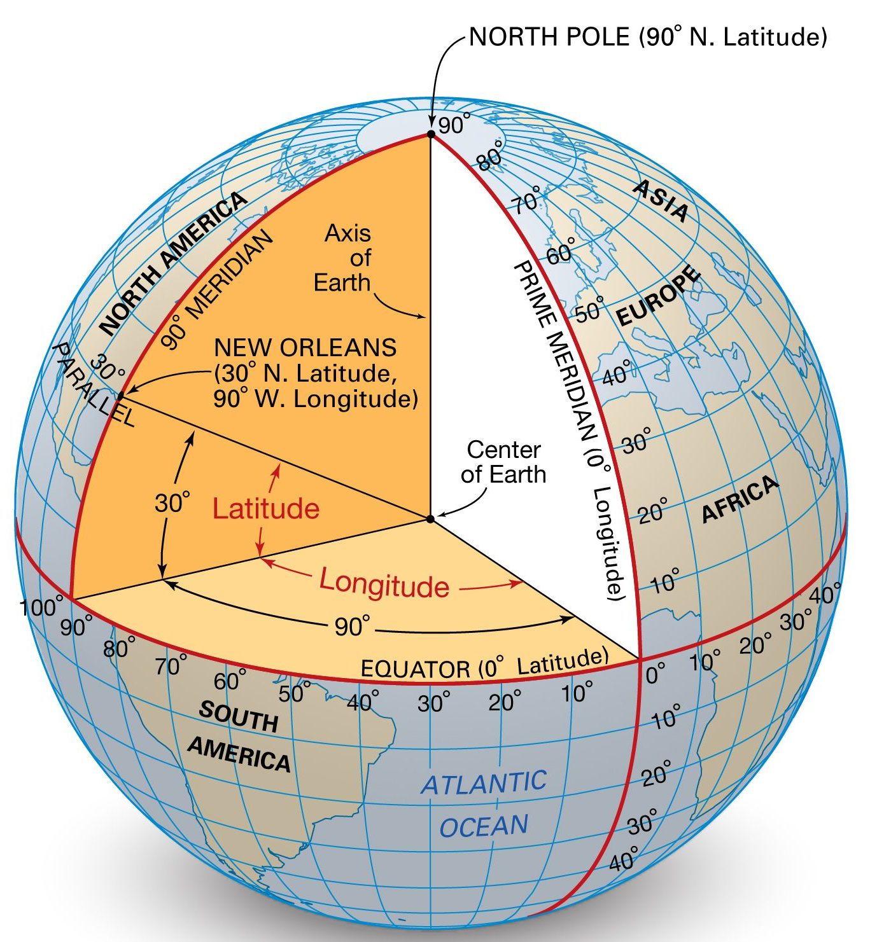
Geographic Coordinate System
A Geographic Coordinate System is a 3D reference framework that locates points on a model of the Earth using angular measurements from the Earth’s center to the surface.
It is spherical / ellipsoidal, not flat. Its grid is the graticule: lines of latitude and longitude.
A GCS has three parts:
Datum
2. Prime meridian; The prime meridian is the line defined as 0° longitude.
3. Angular unit; The unit of a GCS is an angle, usually:
decimal degrees (34.5289°) — most common in GIS
GIS Application in Telecom | Day 1 23 / 51

Slide 24
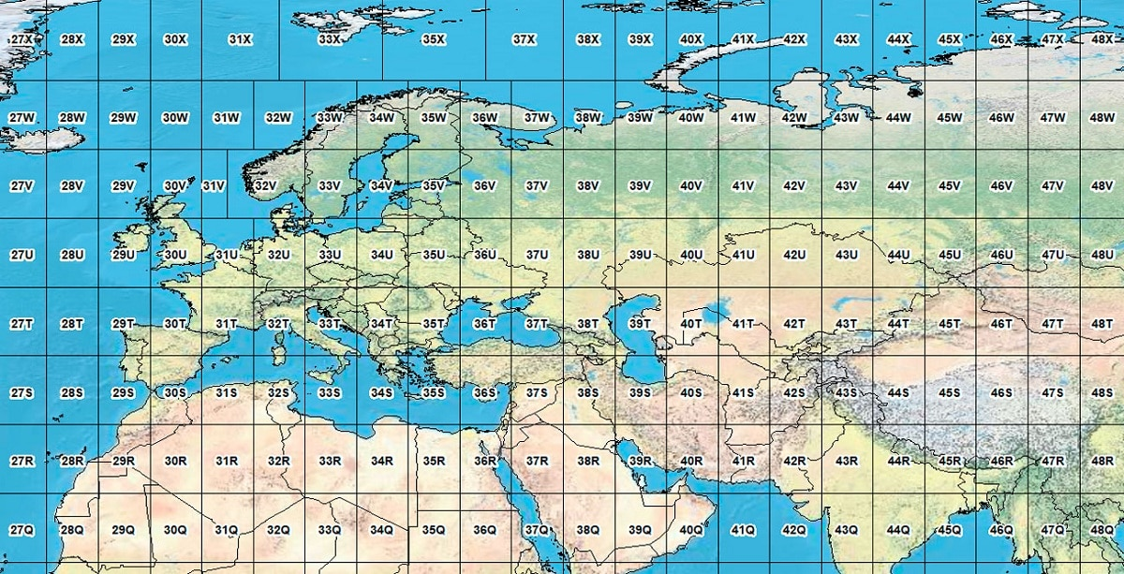
Projected Coordinate System
A Projected Coordinate System is a flat, 2D Cartesian grid created by applying a map projection to a geographic coordinate system.
It locates points using linear units (usually meters) from an origin: easting (X) and northing (Y).
What a PCS is made of:
Every PCS contains a GCS; Example: WGS 84 / UTM zone 42N contains the GCS WGS 84.
A map projection, UTM.
A linear unit, usually meters. Sometimes US survey feet or international feet.
GIS Application in Telecom | Day 1 24 / 51

Slide 25
Part 3 · ArcGIS Pro and the Geodatabase
Projects, feature classes, domains, subtypes, and relationships
GIS Application in Telecom | Day 1 25 / 51

Slide 26
Introduction to ArcGIS Pro
ArcGIS Pro is Esri’s professional desktop GIS application. It is the replacement for ArcMap, ArcCatalog, ArcScene, and ArcGlobe — all in one program. It is designed to run on 64-bit computers.
With ArcGIS Pro we can do:
View and edit maps in 2D and 3D
Manage GIS data (shapefiles, geodatabases, services) Analyze spatial data (buffers, overlays, traces)
Design print layouts
Share maps to ArcGIS Online or ArcGIS Enterprise
Work with modern datasets such as Utility Network.
GIS Application in Telecom | Day 1 26 / 51

Slide 27
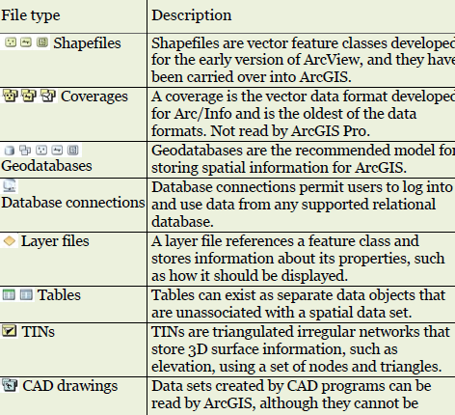
Managing Vector Data in ArcGIS Pro
As previously described, the vector data model is designed to handle the storage of discrete objects on the earth’s surface, such as sampling sites, roads, or parcels. Vector data uses a series of x-y locations to store information as points, lines, or polygons.
ArcGIS can read a variety of GIS file formats; some are native to ArcGIS, and some originate from other sources. In addition, some may be local, and some may be hosted as online data from
ArcGIS Portal.
GIS Application in Telecom | Day 1 27 / 51

Slide 28
Geodatabase
In ArcGIS, the geodatabase is the native container for GIS data, it is Esri’s database for storing, querying, and managing spatial and nonspatial GIS data in one place.
It is more than a folder of shapefiles. It can store:
geometry (points, lines, polygons)
Feature class, feature dataset
attributes
rules (domains, subtypes)
relationships
networks, topology, parcel fabric
GIS Application in Telecom | Day 1 28 / 51

Slide 29
Types of Geodatabases
There are three types of geodatabases used by ArcGIS.
A personal geodatabase is stored in a single Microsoft Access file. This file is limited to 2 GB in size and works only in the Windows operating system. ArcGIS Pro does not recognize this format, and it must be upgraded to a file geodatabase in ArcCatalog before it can be used with Pro.
A file geodatabase is stored in a system folder, and each file can be up to 1 TB in size. File geodatabases can be accessed by multiple operating systems, including Linux and Unix.
An enterprise geodatabase stores GIS data within a commercial relational database management system (RDBMS), such as Oracle® or SQL Server®. Enterprise geodatabases are designed to meet security and management needs for large data sets edited by many simultaneous users.
GIS Application in Telecom | Day 1 29 / 51

Slide 30
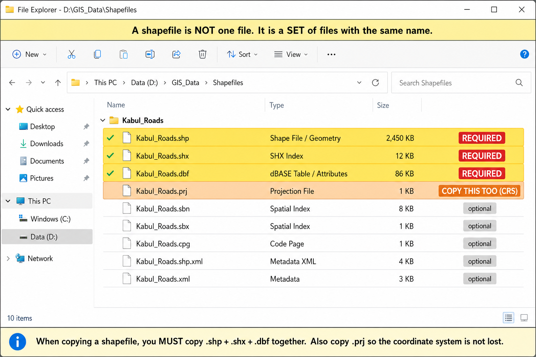
Other GIS Data Types
Shapefile: A shapefile is a spaghetti data format containing a feature class composed of points, lines, or polygons. The table attributes are stored in a dBase file. Shapefiles cannot store domains, subtypes, relationship classes, or topology.
Feature class: A feature class is a collection of geographic features that all have:
the same geometry type (all points, or all lines, or all polygons)
the same attribute fields
the same spatial reference (same datum + coordinate system)
GIS Application in Telecom | Day 1 30 / 51

Slide 31
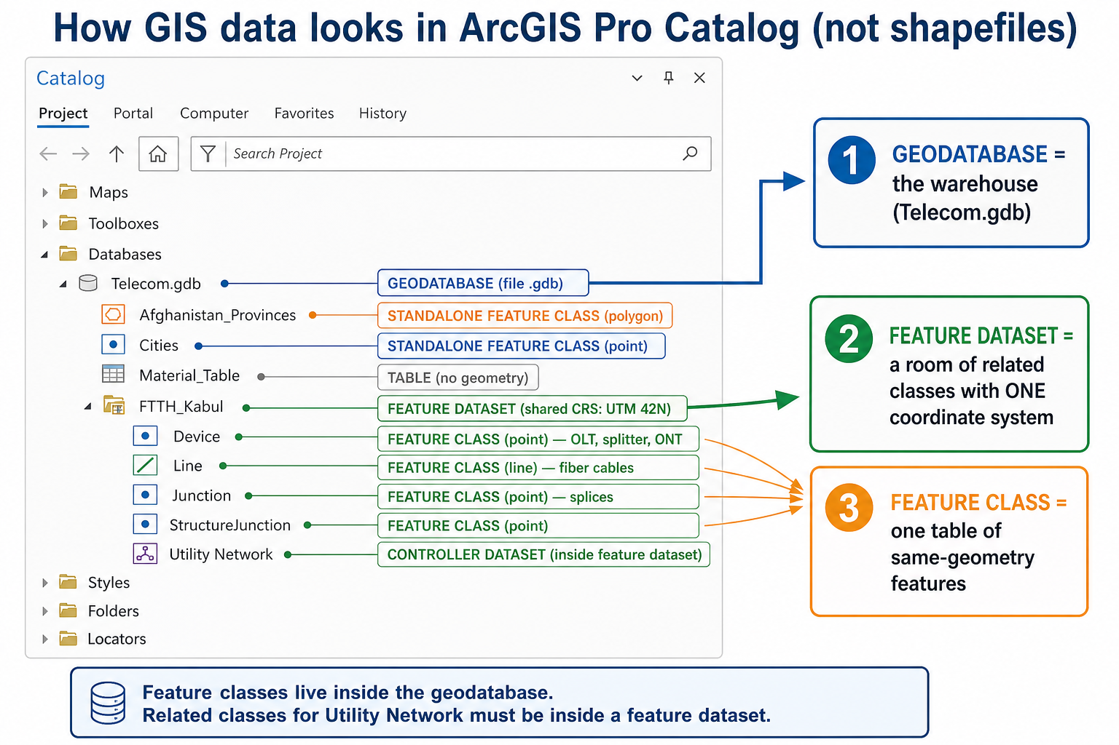
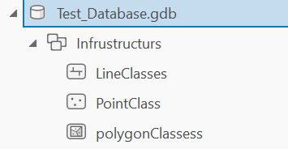
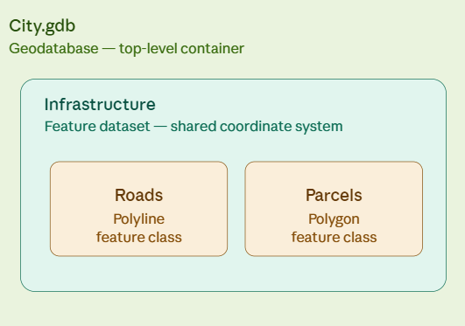
Feature Dataset
Feature dataset: A feature dataset is a container inside a geodatabase that holds related feature classes sharing one coordinate system.
GIS Application in Telecom | Day 1 31 / 51

Slide 32
Domains and Subtypes in Geodatabase
Both domains and subtypes are used to enforce data integrity inside a geodatabase by allowing valid values and rejecting invalid values.
A domain is a geodatabase rule that limits what can be stored in an attribute field. The domain lives in the geodatabase, not inside one shapefile. You create it once, then assign it to fields on one or many feature classes.
There are two types of domains:
Coded value domain (a list)
A list of codes plus labels. The database stores the code; the map shows the description.
Range domain (min and max): a number field must stay between a minimum and a maximum.
GIS Application in Telecom | Day 1 32 / 51

Slide 33
Subtypes
A subtype is a subset of features inside one feature class, defined by an integer field (the subtype field). It is still possible to have one feature class (one table, one geometry type); subtypes are categories of rows in that table.
Example — Towers feature class, field TowerType: 1 = Macro tower 2 = Small cell 3 = Rooftop antenna
Aspect | Subtypes | Domains
What it is | Splits one feature class into meaningful categories using an integer field | Restricts what values are allowed in a field (a validation rule)
Applies to | The whole feature class/table (one subtype field per class) | Any individual field, reusable across many feature classes
Purpose | Groups features that behave differently (different rules, defaults, connectivity) | Prevents invalid data entry (typos, out-of-range values)
Storage | Stored as an integer code in one designated field | Can be coded value (a fixed list) or range (min/max)
Reusability | Defined once per feature class, not shared elsewhere | Defined once in the geodatabase, can be attached to many fields/feature classes
Behavior control | Can have its own default values, unique field defaults, and connectivity rules per subtype | Only validates — doesn't change other field behavior
GIS Application in Telecom | Day 1 33 / 51

Slide 34
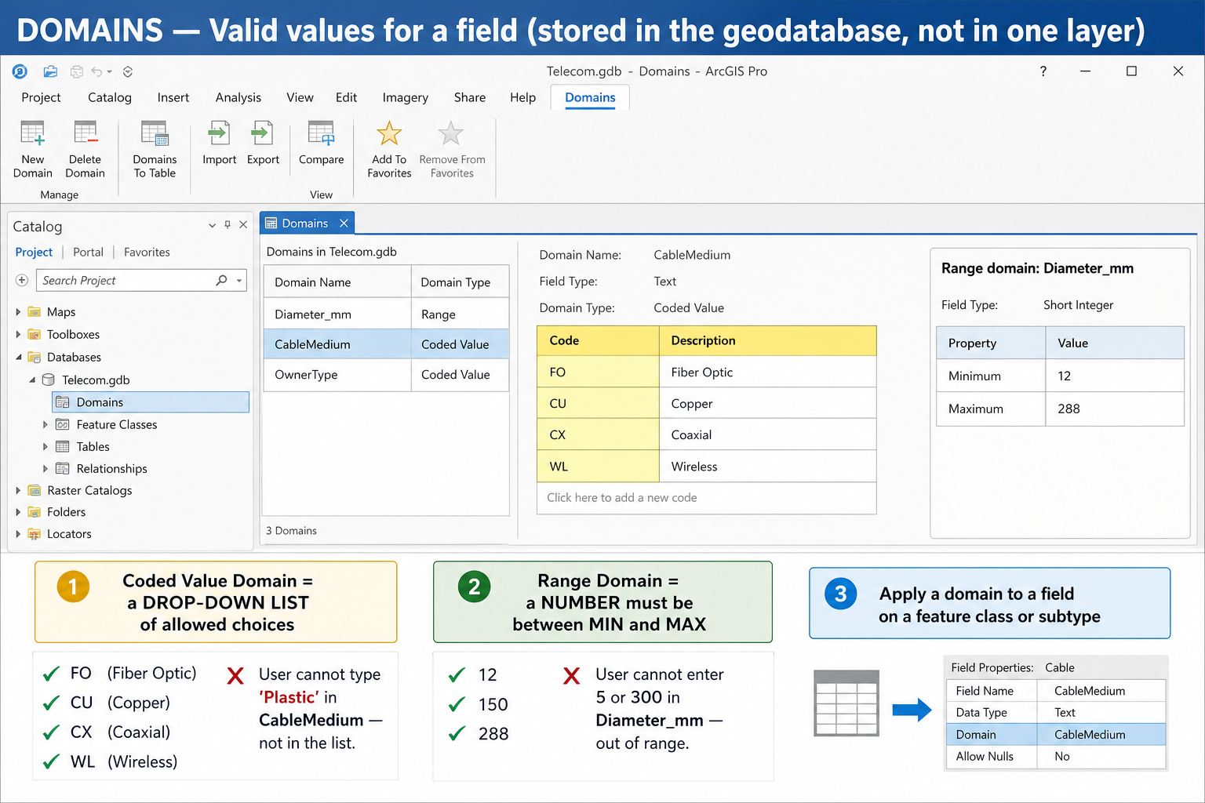
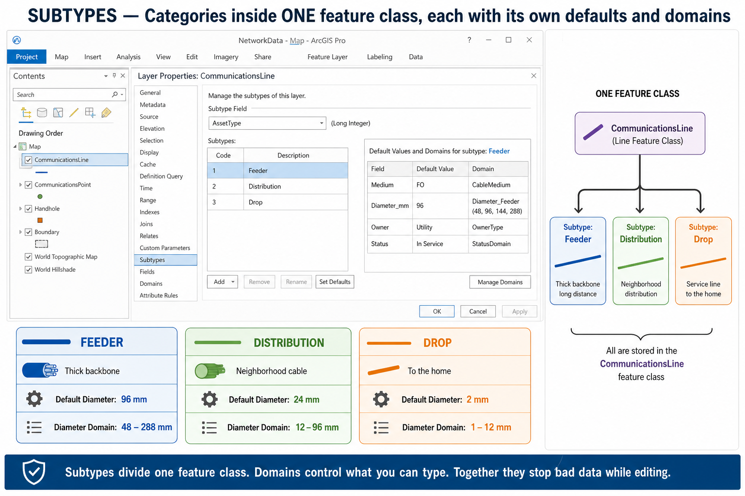
Domains and Subtypes — Example
Visual example in ArcGIS Pro
How a coded-value domain and subtypes appear in the geodatabase (fields / subtypes view).
You create the rule once in the geodatabase, then assign it to a field. Editors pick from the list instead of typing free text.
GIS Application in Telecom | Day 1 34 / 51

Slide 35
Relationship Classes
A Relational Database is a standardized and organized way of storing and managing data using tables that are logically linked together through common fields (keys).
In an ArcGIS geodatabase, the relational database model is extended to efficiently manage both spatial data (geometry: points, lines, polygons) and attribute data (descriptive information) in a single integrated system.
A relationship class defines how two tables or feature classes are connected to each other — like a foreign key relationship in a normal database but built into the geodatabase itself.
Core Purpose: Instead of manually joining tables every time, a relationship class lets you permanently link related records — so when you select a feature, you can instantly see (or edit) its related records in another table
GIS Application in Telecom | Day 1 35 / 51

Slide 36
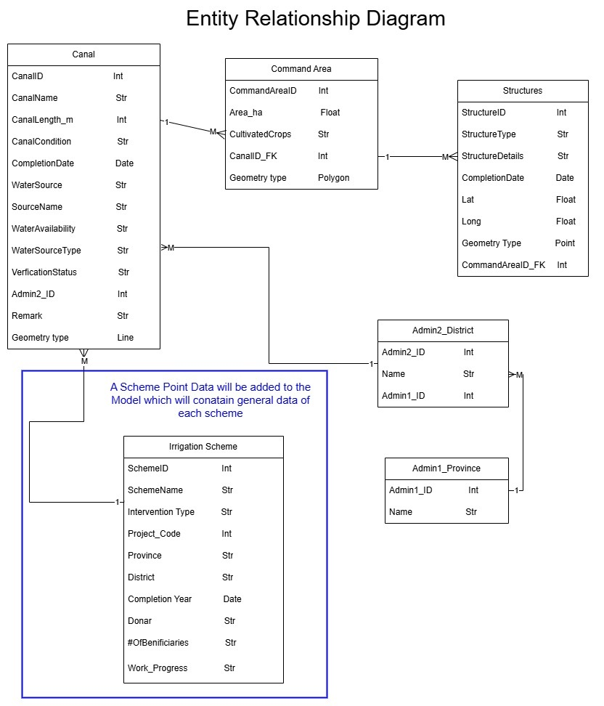
Example of ERD
An Entity-Relationship Diagram (ERD) is a type of structural diagram used in database design to visualize the relationships between different entities within a system. ERDs are particularly useful for understanding the logical structure of databases, including entities, their attributes, and relationships between them
GIS Application in Telecom | Day 1 36 / 51

Slide 37
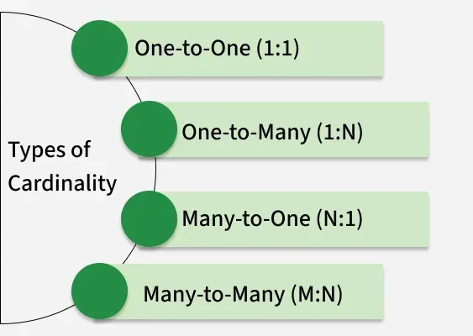
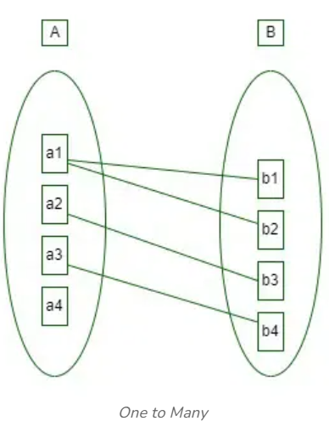
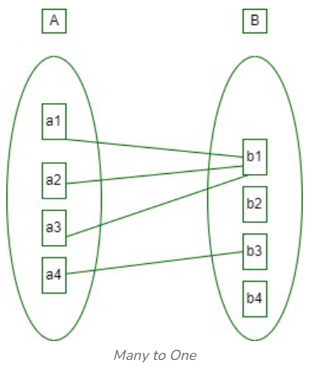
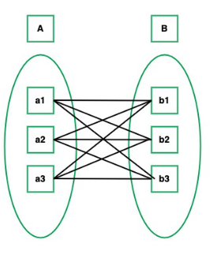
Cardinality in Geodatabase
Cardinality describes how many records in one table/feature class can relate to how many records in another table/feature class, within a relationship class.
A relationship class is the geodatabase’s foreign key.Origin holds the primary key. Destination holds the matching key.1-M is the usual telecom pattern (one cabinet, many ports).Composite means children belong to the parent and are deleted with it.
GIS Application in Telecom | Day 1 37 / 51

Slide 38
Irrigation Example:
Hierarchical Relationships
Scheme
Scheme (Parent)
Top of the hierarchy
Each Scheme has at least one subproject (Irrigation rehabilitation, RBP)
Identified by scheme_id (Primary Key)
Geometry: Point
1 : Many
Canal
Canal (Child / Parent)
Second top of the hierarchy
Each canal can supply multiple irrigated area
Identified by canal_id (Primary Key)
Geometry: Polyline
1 : Many
Command Area (Child / Parent)
Command Area
Child of Canal via canal_id (FK)
Parent of Structures
Defines the irrigated coverage area
Geometry: Polygon
1 : Many
Structures
Structures (Child)
Child of Command Area via area_id (FK)
Represents physical infrastructure
Types: intake, super passage, Weir
Geometry: Point
Telecom parallel (1:M): OLT → many FDHs → many splitters → many homes. Same cardinality idea; different features.
GIS Application in Telecom | Day 1 38 / 51

Slide 39
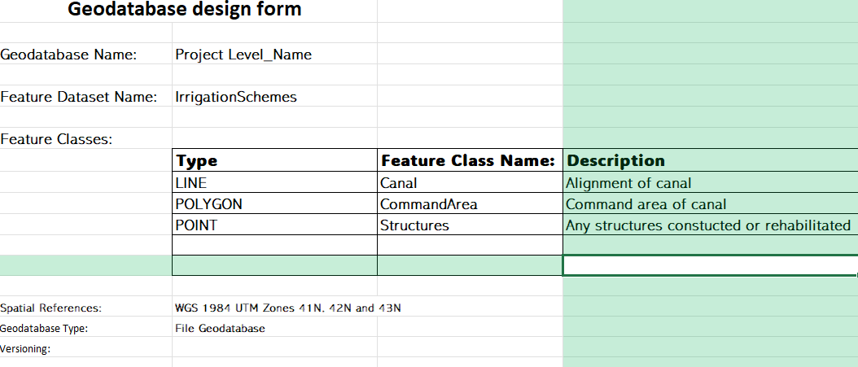
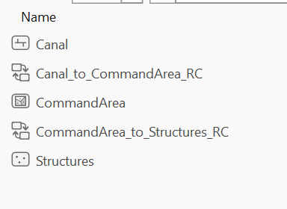
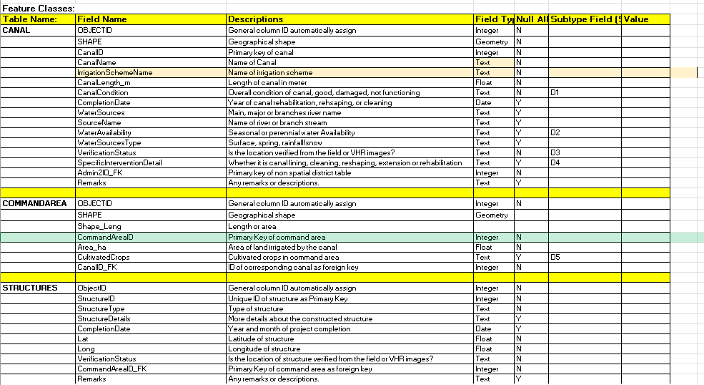
Geodatabase design of one Irrigation project
GIS Application in Telecom | Day 1 39 / 51

Slide 40
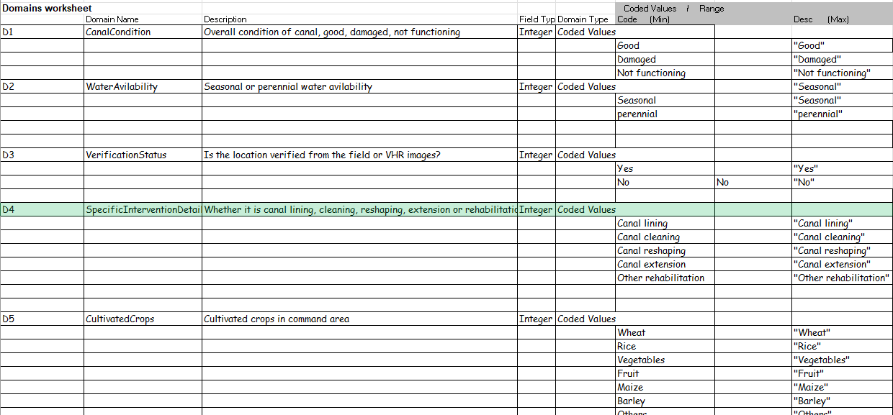
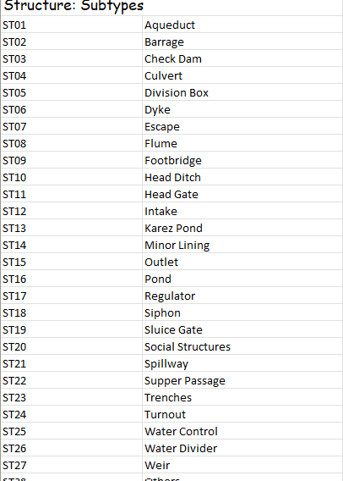
Irrigation geodatabase — screenshots (cardinality example)
GIS Application in Telecom | Day 1 40 / 51

Slide 41
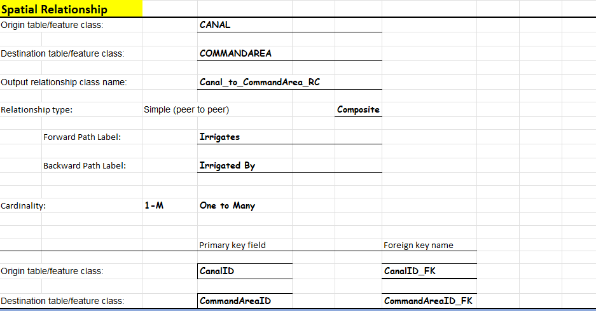
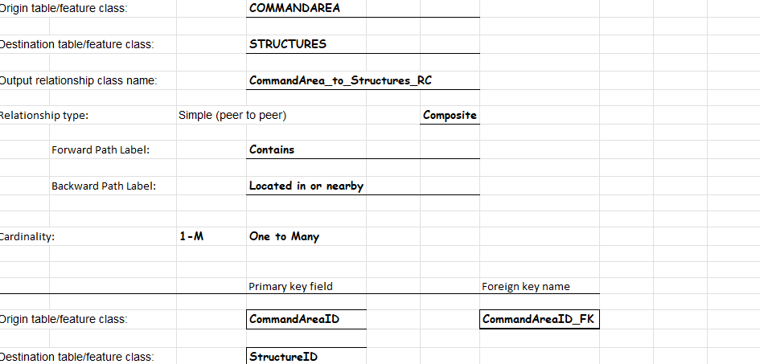
Irrigation geodatabase — screenshots (cardinality example)
GIS Application in Telecom | Day 1 41 / 51

Slide 42
Part 4 · Raster Analysis and DEM
Continuous surfaces, overlay, resolution, and elevation
GIS Application in Telecom | Day 1 42 / 51

Slide 43
Raster Analysis in ArcGIS Pro
Discrete data models deal with spatial objects as points, lines, or polygons, but other approaches are needed to store and model continuous surfaces that are based on measured quantities, such as elevation, that vary from place to place on the earth.
Rasters excel at storing continuous data, which are quantities or variables that change over the earth’s surface. A digital elevation model (DEM) stores elevation values. Cells are unlikely to have the same elevation as their neighbors, and the values range smoothly into one another, forming a continuous surface (or continuous field). Therefore, they are commonly called continuous rasters. Precipitation, population density, temperature, and cloud cover are other examples of variables that can be measured over space and stored in raster format as continuous data.
GIS Application in Telecom | Day 1 43 / 51

Slide 44
Different Raster Analysis
Raster analysis means creating a new grid from one or more rasters by applying a rule to each cell. Below are some types of common raster analysis in ArcGIS Pro:
Reclassify: Reassigns cell values into new categories (e.g. elevation → low/medium/high)
Zonal Operations: Summarize raster values within defined zones (often using a separate zone raster or polygon).
Euclidean Distance: Straight-line distance from each cell to the nearest source feature
Raster Calculator / Map Algebra: Apply math expressions directly to raster values (e.g. NDVI = (NIR - Red) / (NIR + Red)).
Viewshed: Determines what's visible from a given observation point
GIS Application in Telecom | Day 1 44 / 51

Slide 45
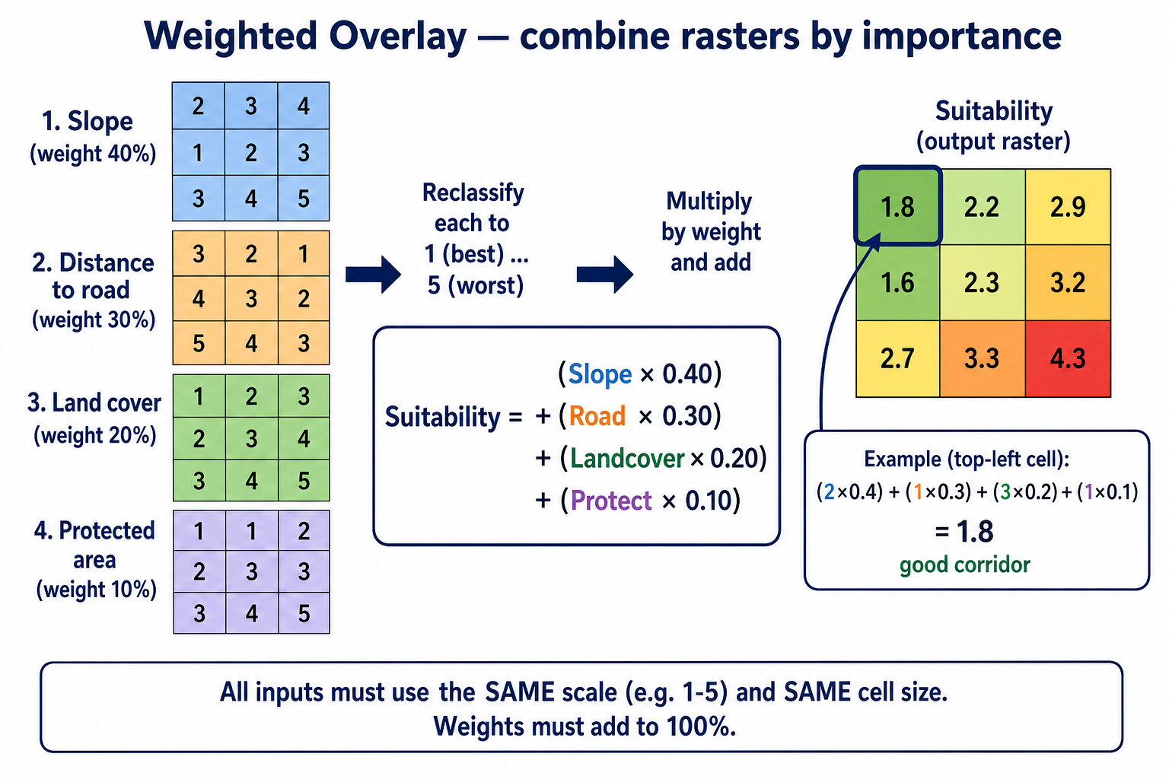
What Is Weighted Overlay?
Weighted Overlay is a raster analysis method that combines several layers into one suitability map, by:
Putting every layer on the same score scale (for example 1 = good, 5 = bad)
Giving each layer an importance weight (percent)
Adding them together
The result is one raster: where is the best place (or corridor) according to your rules.
GIS Application in Telecom | Day 1 45 / 51

Slide 46
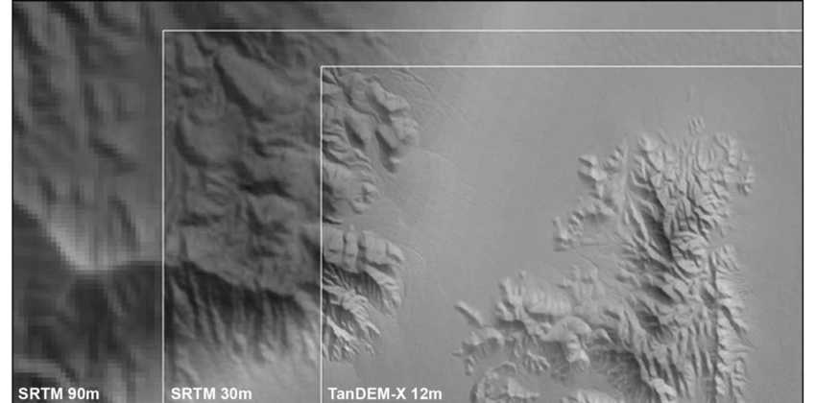
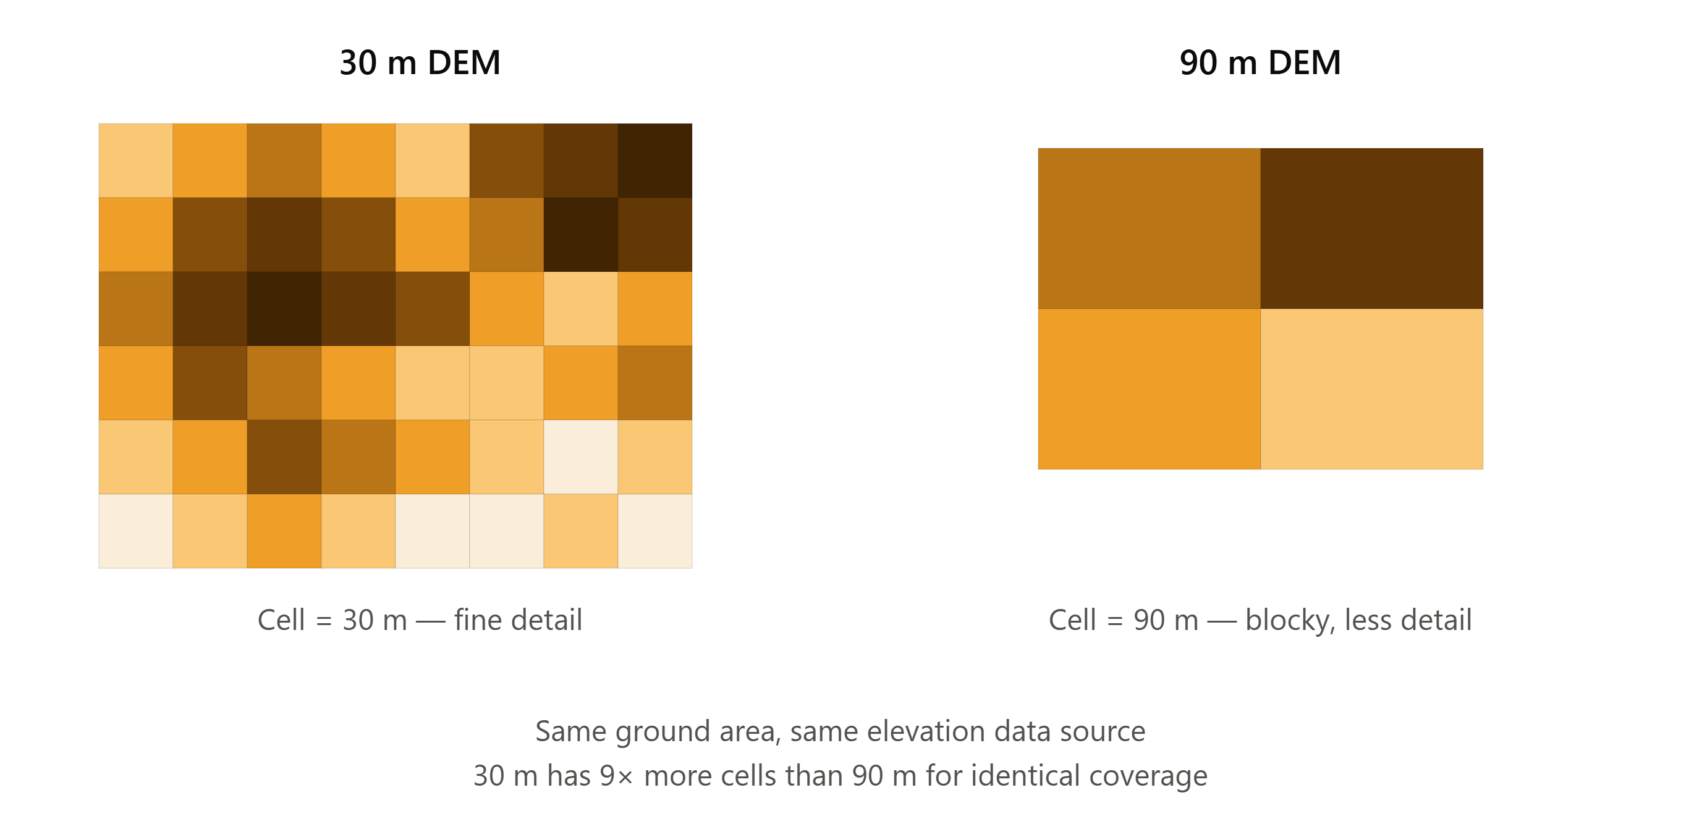
Raster Resolution
The x and y dimensions of each pixel define the resolution of the raster data. The higher the resolution, the more precisely the data can be represented.
GIS Application in Telecom | Day 1 46 / 51

Slide 47
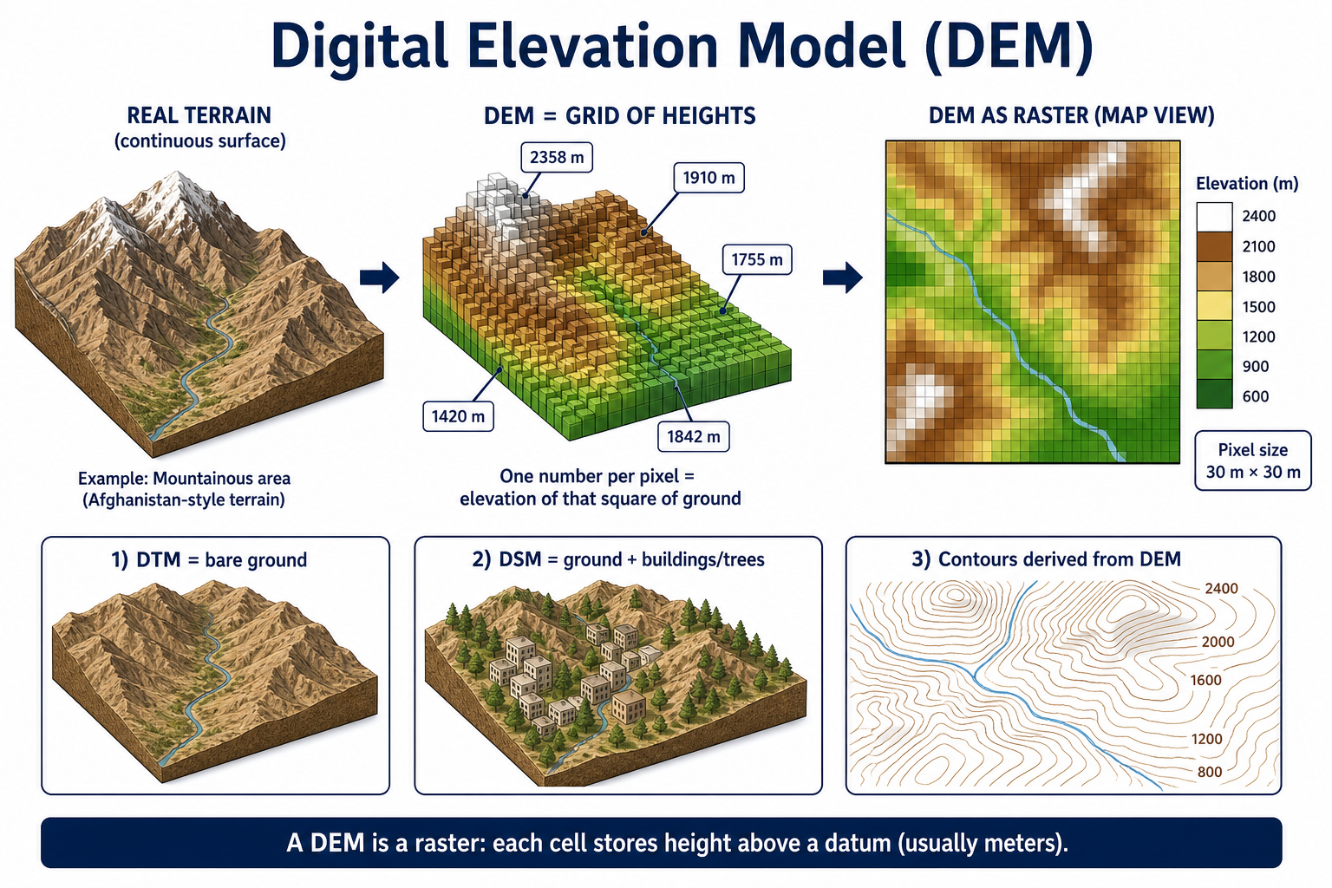
What is a Digital Elevation Model (DEM)?
A Digital Elevation Model (DEM) is a digital map of the height of the ground. The land is stored as a raster (a grid of squares). Each pixel has one number: elevation above mean sea level.
If the DEM is 30 m resolution, one elevation number represents all the ground in that 30 × 30 m square. Hills smaller than a pixel are averaged or missed.
GIS Application in Telecom | Day 1 47 / 51

Slide 48
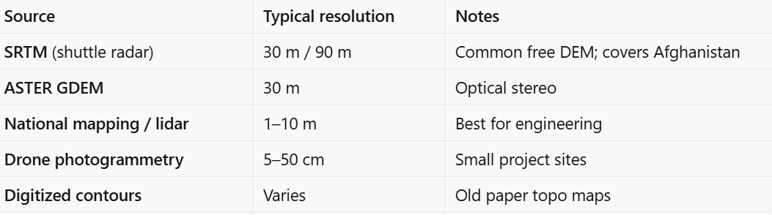
DEM Sources
Below are some sources of DEM:
GIS Application in Telecom | Day 1 48 / 51

Slide 49
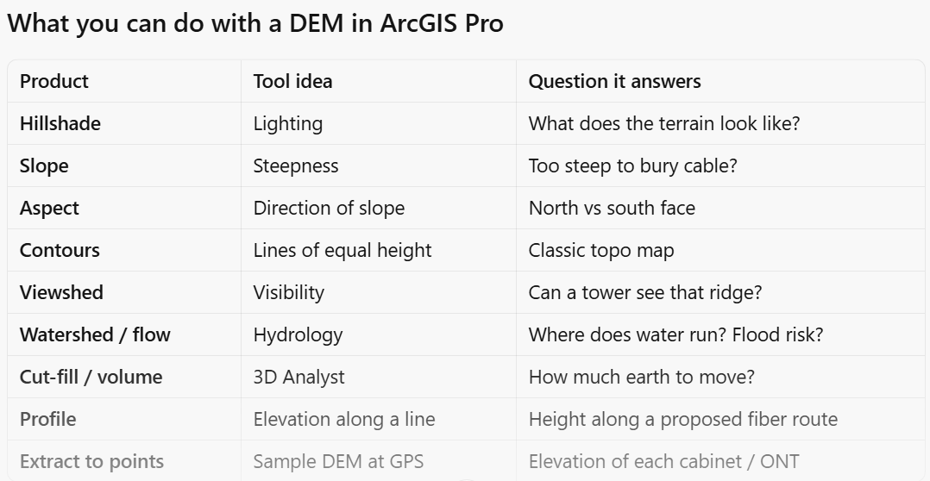
What Can Be Extracted from a DEM
From a DEM you can derive:
• Slope — steepness; used for access, erosion, and tower/fiber routing
• Aspect — direction the slope faces; used with RF / solar / ice load
• Hillshade — shaded relief for map reading
• Contours — lines of equal elevation
• Viewshed — what is visible from a tower or candidate site
• Watershed / flow — drainage, flood, and crossing risk
• Cut-and-fill / elevation profile — along a proposed fiber or microwave path
GIS Application in Telecom | Day 1 49 / 51

Slide 50
Let’s Explore It in ArcGIS Pro
GIS Application in Telecom | Day 1 50 / 51

Slide 51
Instructor copy — text corrections (yellow on slides)
Remove this slide before class. Yellow highlight on earlier slides = wording we changed.
Trainig → Training; GIS Applications in Telecommunications → GIS Application in Telecom
A Geographic Information Systems → System (singular); GIS use → GIS uses
Rater data → Raster data; Advantage and Disadvantages → Advantages and Disadvantages
abular → Tabular; Attribute Data Descriptive → Attribute Data:
Project Coordinate → Projected Coordinate; ARCGIS PRO → ArcGIS Pro
Continue.. → Feature Dataset / Subtypes
denning invalided → rejecting invalid; Its is possible → It is still possible
Earth / football ball / Geoid wording corrected (ellipsoid vs geoid).
Raster excel → Rasters excel; one or more raster → rasters; some source → sources
supper passage → super passage; Shapefiles sentence completed (no topology/domains).
DEM extract list added (slide was title-only). Telecom 1:M note added to irrigation example.
Vector Data Format moved to sit with vector content (before raster format).
Day 1 Agenda + Learning Outcomes built from the content of the following slides.
Fonts standardized to Calibri (titles 32 pt bold, body 18 pt, tables 14 pt).
GIS Application in Telecom | Day 1 51 / 51

